Slide 1



Slide 2

AI Based Inventory and Sales Optimizer
Supervised by:
Ms Sadia Ijaz
Group Members:
Adeel Ahmed (FA17-BCS-061)
Muhammad Haris (SP17-BCS-053)
Department of Computer Science
COMSATS University Islamabad, Attock Campus

Slide 3
Outline
Introduction
Problem statement
Objectives
Methodology
Functional requirements
Existing apps
Tools and technology
Benefits
Diagrams
System screenshots
References

Slide 4
Introduction
“AI Based Inventory and Sales Optimizer” is an android app which will allow shop or warehouse owners to track the inventory status and keep an on eye on daily business activities and stats simply through their mobile phone.
Not only this but the main purpose behind the development of this app is to keep the inventory updated with the stock of the items which users are mostly buying and to forecast the amount of future sales of different items from time to time to keep the stock updated, through the use of ML and data mining algo’s.
Moreover, this app will also preserve user value able data as a backup on local or Google drive storage to import and export data from app.

Slide 5
Problem Statement
So, while proposing this idea we thought about the problems faced by the shop or small warehouse on daily basis to run their business in a smooth way. Because these people usually cannot afford a computer operator or hire any accountant who will be responsible to maintain the records of sales and manually review the inventory for running their business successfully.
So, for their assistance and to facilitate them from their smartphones our free app will a great helping hand for them to get rid of traditional or manual ways of running a business, which will ultimately save their time and money a well. Not only this but it will also help to optimize their sales and keep the inventory stock updated with the most selling products on the basis of smart AI suggestions.

Slide 6
Objectives
The main goals and objectives of our system are listed below;
Tracking all the products details and to visualize them by adding their picture or QR code.
Customizing and organizing each product in different categories for ease.
Updating the products record while selling or buying them by simply just scanning its barcode from the app.
To maintain and track all the records of vendors and customers.
Viewing and analysing sales reports and records on daily, weekly or monthly basis.
Tracking and calculating profits or loss on monthly basis.

Slide 7
Objectives (continue)
To get notified about low stock products or to check inventory status just on a button click.
To have a backup plan for user data on local or Google drive storage.
Keeping different items in stock based on AI suggestions or future sales predictions through data mining algorithms.

Slide 8
Methodology
User will provide the required details for login or signup process, as an initial step in order to use this application.
User will then setup his inventory database when using this app for first time. He can enter different details about the stock products and can also upload their image and barcode. Further, he can customize his stock products in different categories for his ease.
User can also enter the details about his vendors and customers which will be used at the time of purchasing or selling any item.
User has the authority to view and edit each record of products, vendors or customers so he can update or delete them.
User can track all the business stats and reports to get an idea about the items selled or purchased, profit or loss etc on different time basis.

Slide 9
Functional requirements
These are some of the functional requirements of our system;
Allows the user to signup on using the app for first time.
User can login into the app after signing up successfully.
Add inventory items with their details, and can also upload their image and barcode.
Customize the items on basis of different categories and brands.
Add customers and vendors details.
Update any item details by just simply scanning its barcode from the app during selling or purchasing it.
Review and update all the details of products, vendors and customers by simply filtering out on different factors.

Slide 10
Functional requirements (continue)
User can view and track all the stats and records of sales and purchase, profit and loss on different time period.
The system will update the user about real time stats of the products in his stock. Moreover, user can just check shortlisted items that are in low stock just on a button click.
Use of local or Google drive storage to backup valuable data of the user.
To predict or forecast the future sales of any product through the use of ML algorithms like ‘Neural network’ to keep the stock updated.
To know about the most selling products and the one which is often sold usually with the other products through the use of data mining algo’s.

Slide 11
Existing apps
Features | AI Based Inventory and Sales Optimizer | Stock Manager | Daily Sales Record | Store Manager
Products Details | ✔ | ✔ | ✔ | ✔
Product Type/Categories | ✔ | ✖ | ✖ | ✔
Customer/ Vendor Detail | ✔ | ✖ | ✔(only customers) | ✔(only customers)
Low Stock Alert | ✔ | ✖ | ✖ | ✔
Stats/Report | ✔ | ✔ | ✔ | ✔
Barcode Scanner | ✔ | ✖ | ✖ | ✔
Smart analysis | ✔ | ✖ | ✖ | ✖
Sales prediction | ✔ | ✖ | ✖ | ✖
Data Backup | ✔ | ✔ | ✔ | ✖

Slide 12
Tools and Technologies
Tools & Technologies | Rationale
Java, Python | Programming language
MS word | Documentation work
MS PowerPoint | Presentation work
Creately web app | Diagram work
Adobe Illustrator | App graphics
Android Studio | IDE
SQL Real Time Database | Backend work

Slide 13
Benefits
The foremost benefit will be to save time and money, over the traditional paper work system of running any business.
User can customize the items in different categories and can track amount of each item at any time with great ease.
Barcode scanning feature will help to save much time during selling or purchasing any items.
Reports and Stats are automatically generated without any hassle and can be viewed on daily, weekly and monthly basis.
AI is involved to analyse the user data to find out the most selling items.
User is also prompted about the future sales forecast of different items.
User data is saved as a backup on local or Google drive storage.

Slide 14
Diagrams
Use Case Diagram
Activity Diagram
Sequence Diagram
ER Diagram

Slide 15
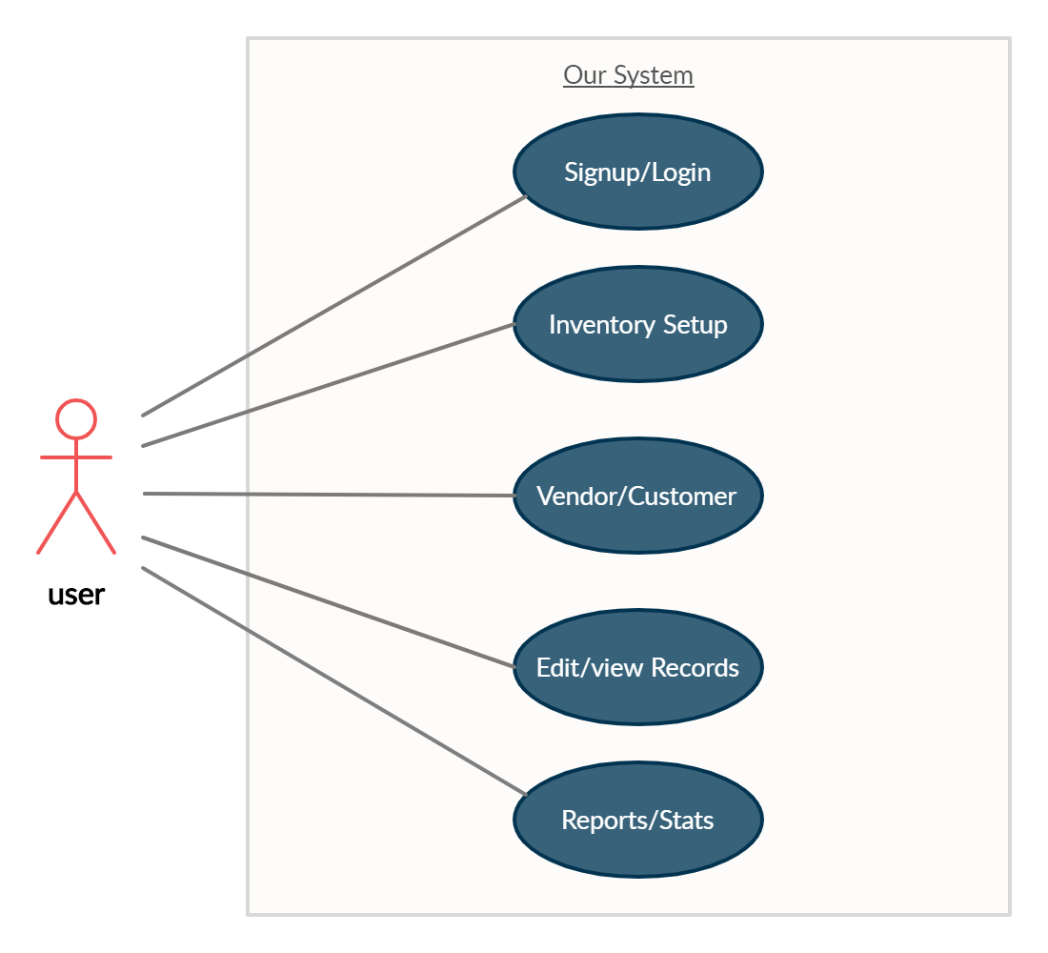
Use case Diagram

Slide 16
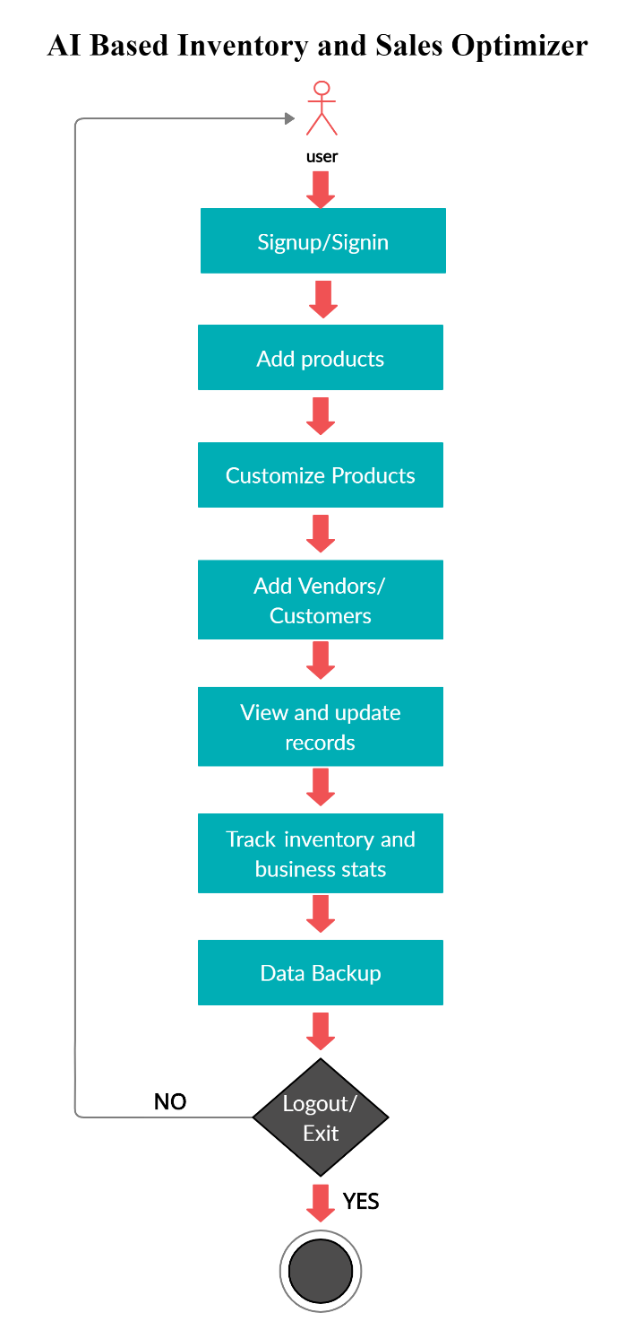
Activity Diagram

Slide 17
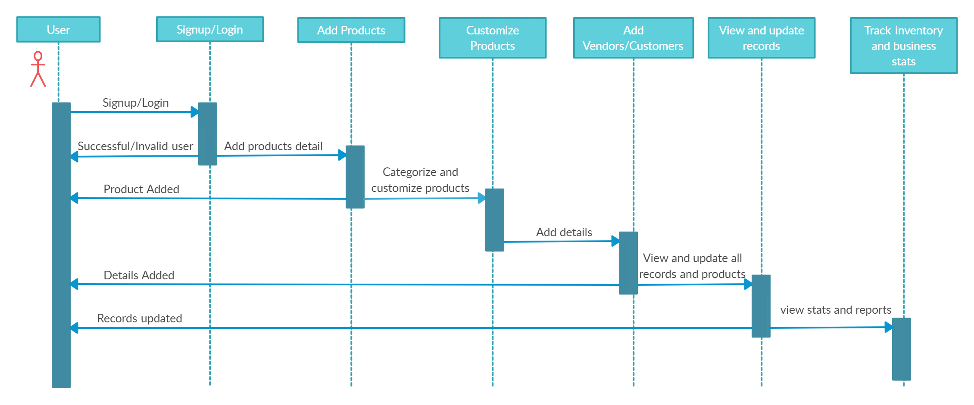
Sequence Diagram

Slide 18
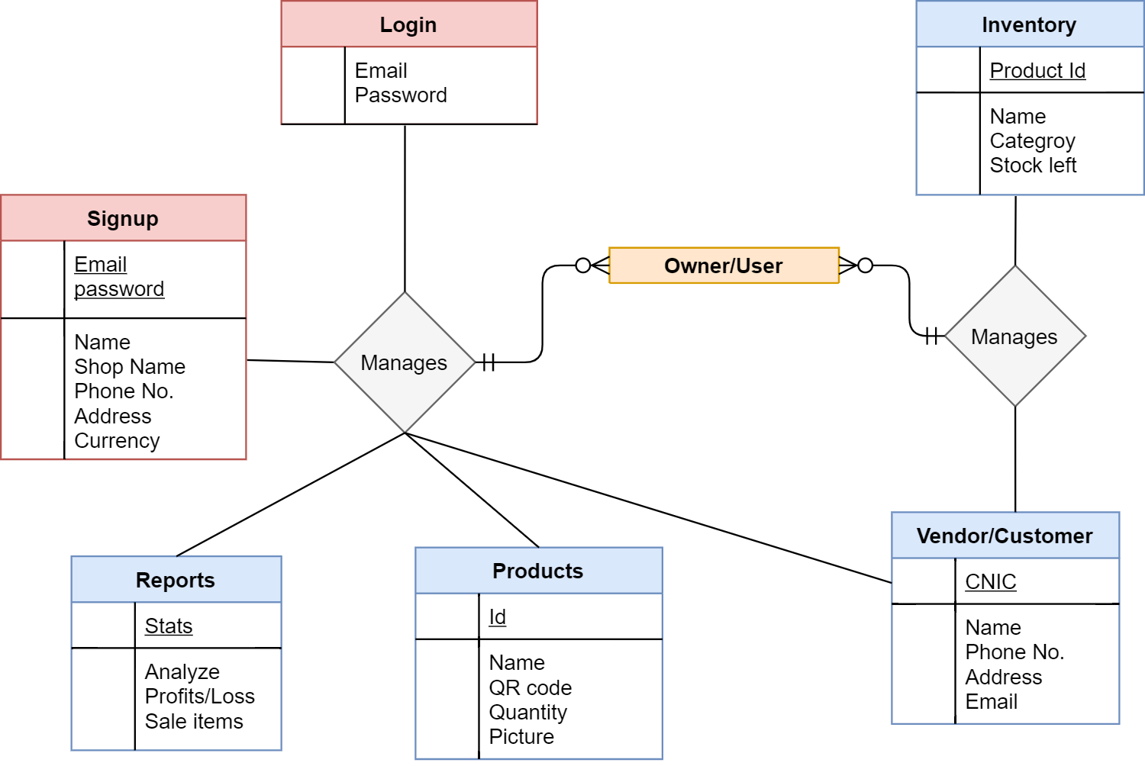
ER Diagram

Slide 19

App Icon

Slide 20
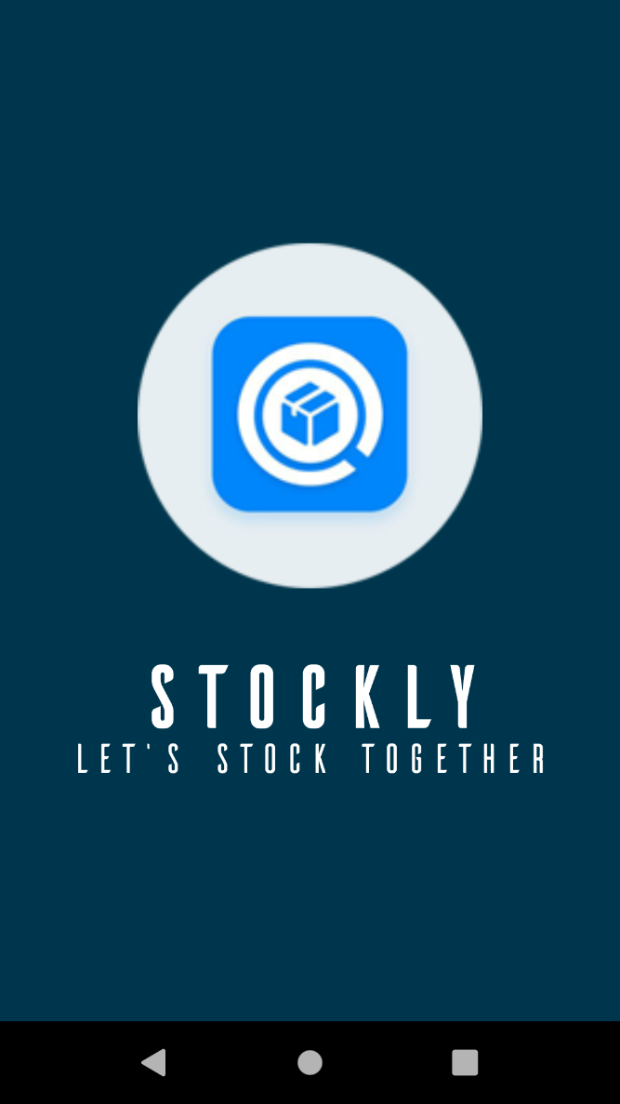
Splash screen

Slide 21
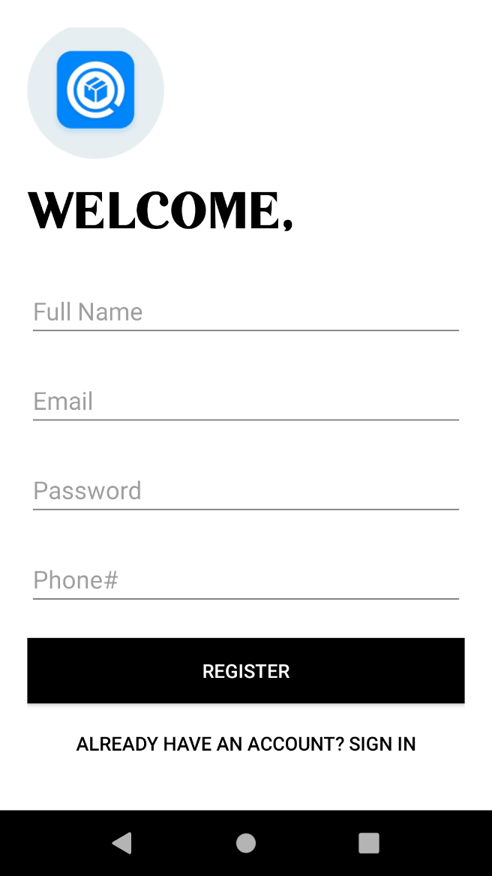
User Signup Screen

Slide 22
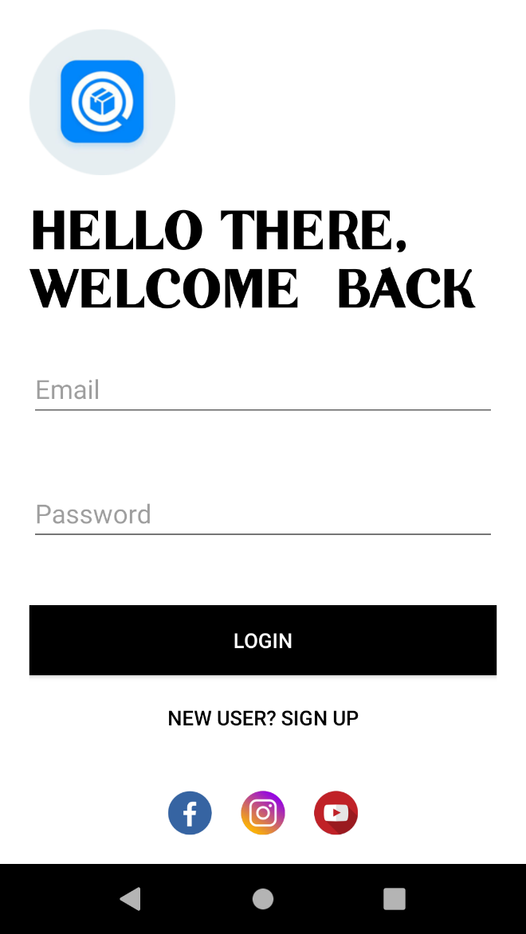
User Login Screen

Slide 23
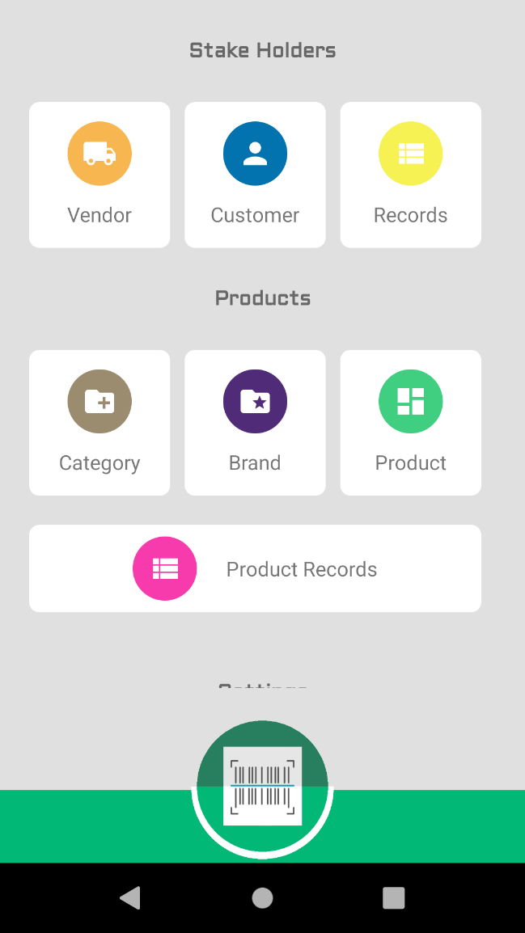
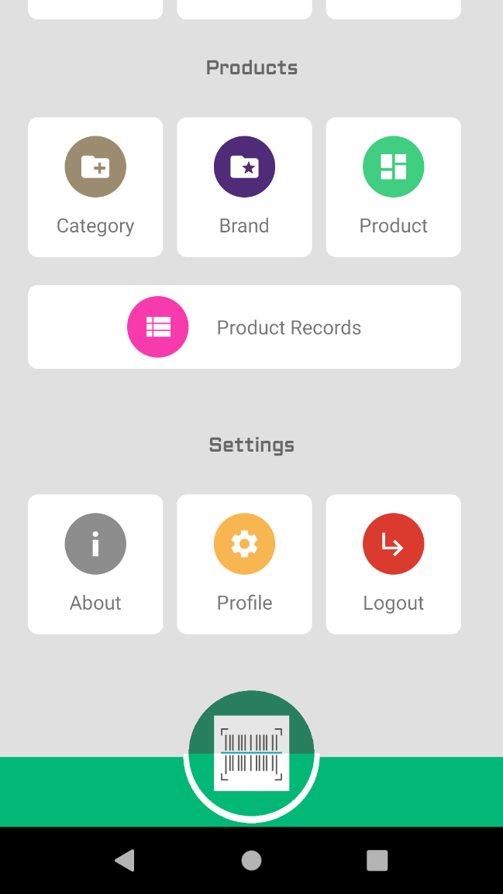
Main Activity Screen

Slide 24
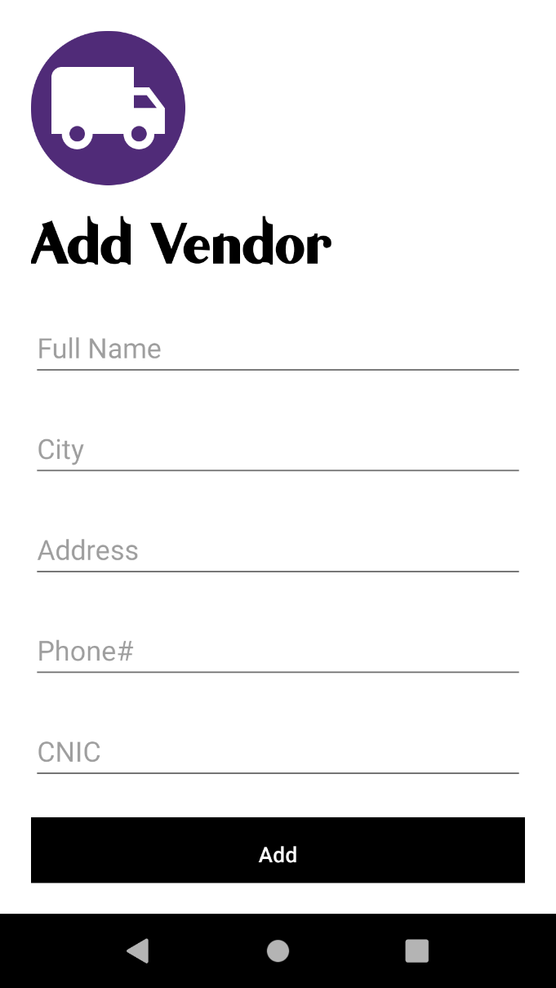
Vendor register screen

Slide 25
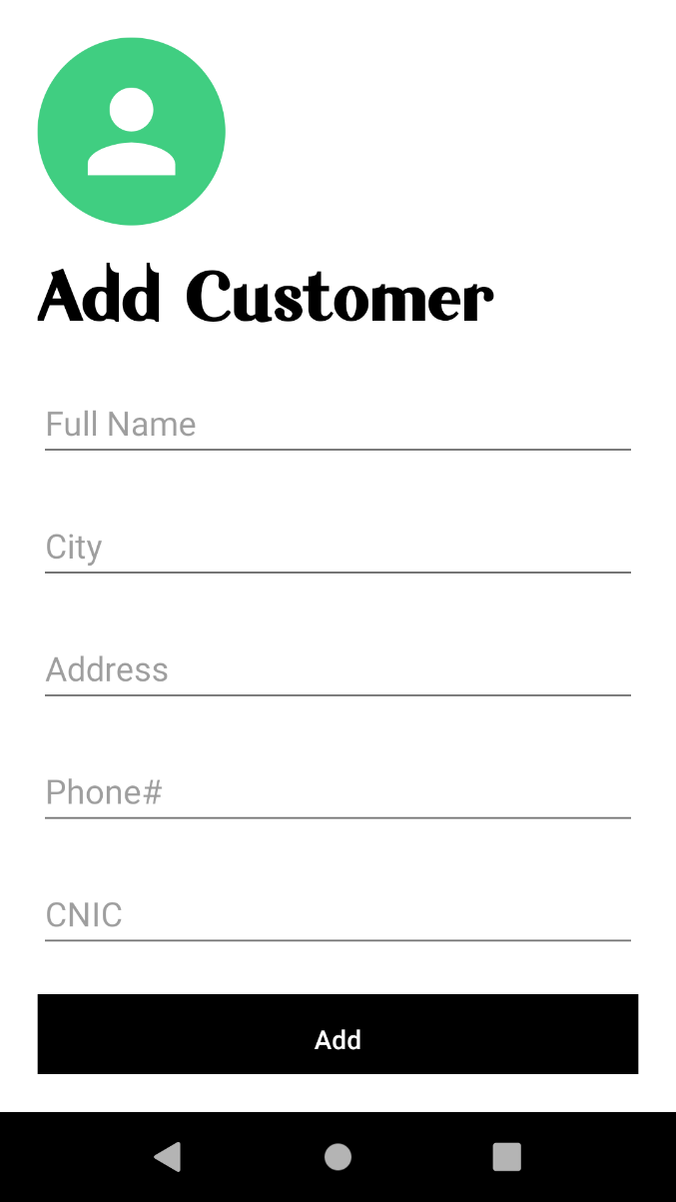
Customer register screen

Slide 26
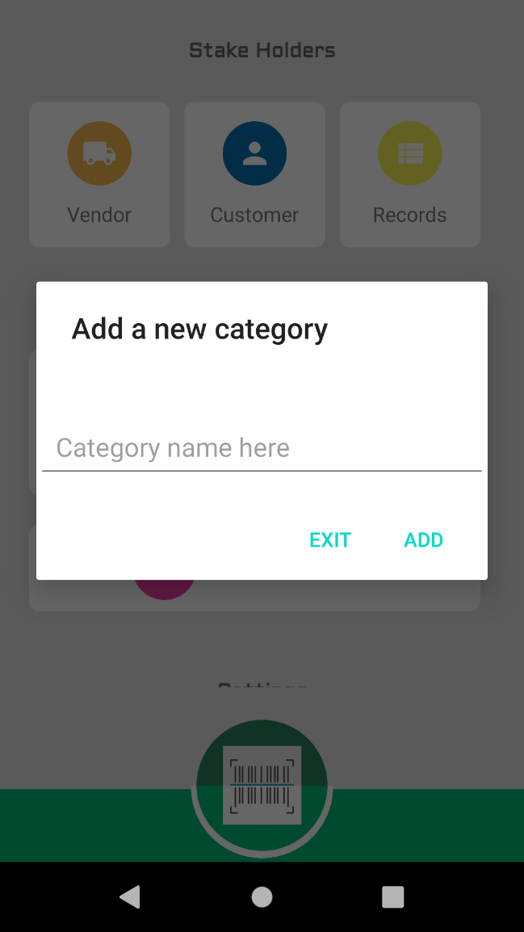
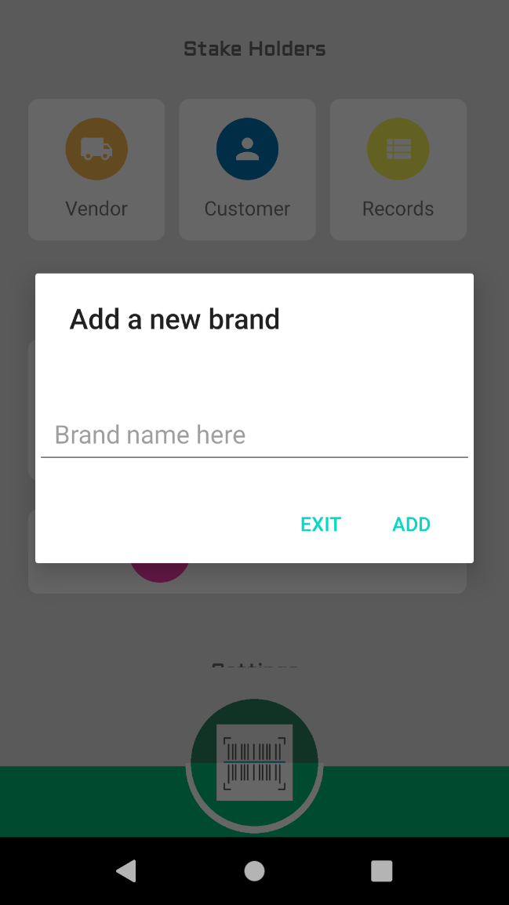
Products add screen

Slide 27
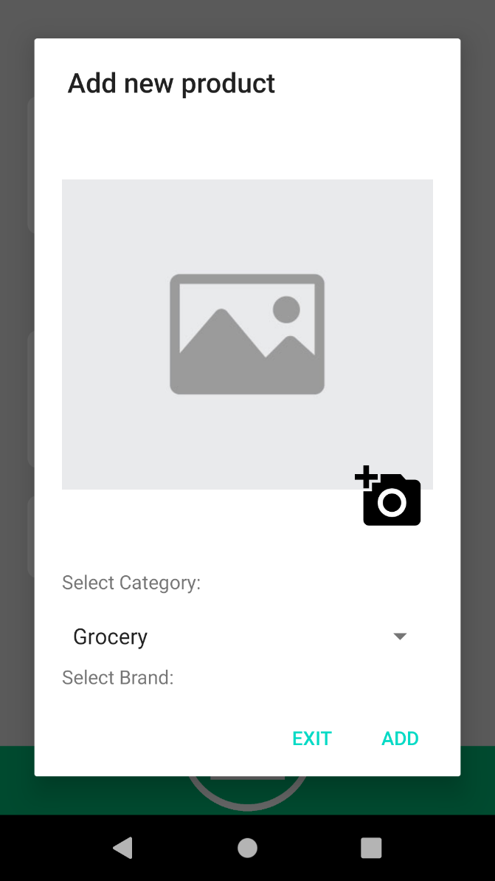
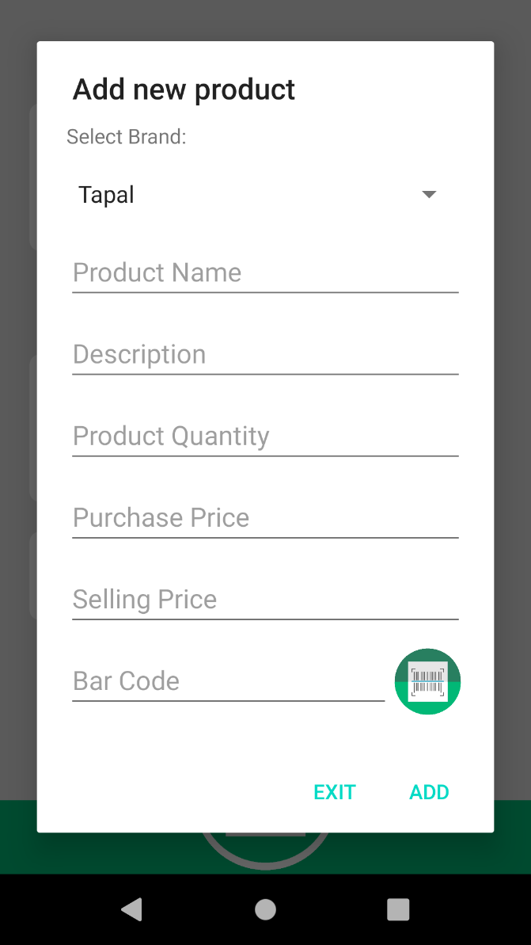
Products add screen

Slide 28
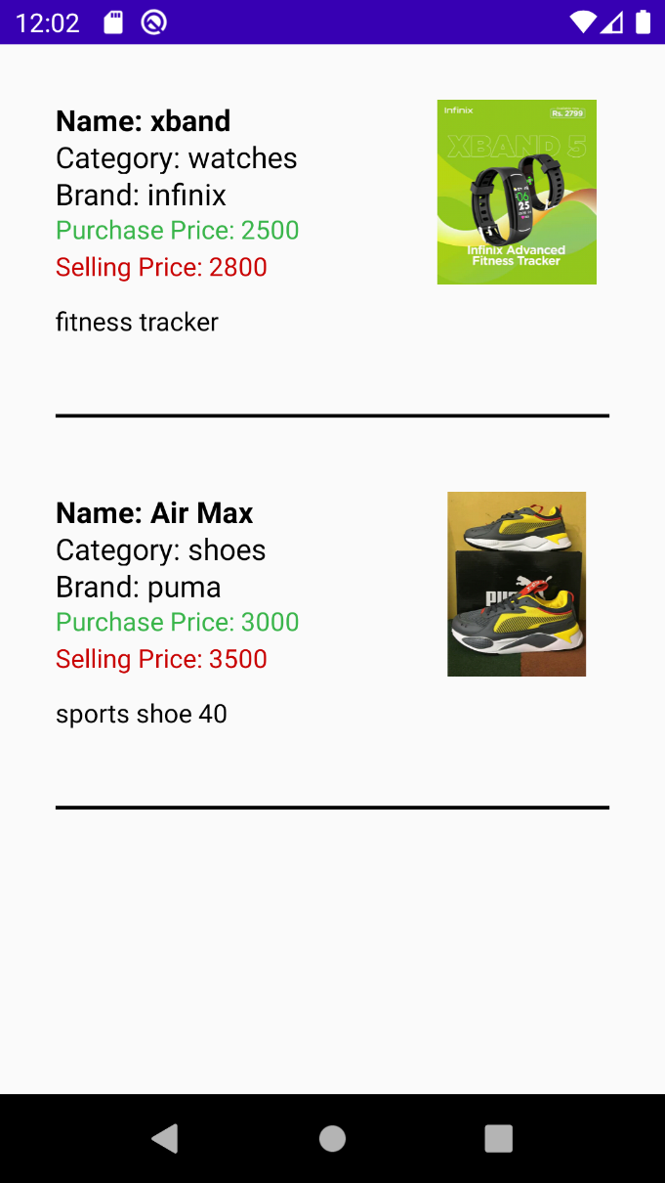
Products record screen

Slide 29
References
https://play.google.com/store/apps/details?id=com.kutirsoft.dailysalesrecord
https://play.google.com/store/apps/details?id=com.inventory.sales.invoice.fmcg.storemanager
https://play.google.com/store/apps/details?id=my.aahmetbas.stockcontroller

